Slide 1
Testing Object-Oriented Software cont …
.
Prof. Durga Prasad Mohapatra
Professor
Dept. Of CSE, NIT Rourkela

Slide 2
UML-Based Software Testing
UML is a design and modeling language for object-oriented software and is widely used as a de facto standard that provides techniques to model the software from different perspectives.
It supports facilities both for abstract high level modeling and for more detailed low-level modeling.

Slide 3
UML-Based Software Testing cont…
It consists of a variety of graphical diagram types that can be extended for specific application areas.
It is associated with a formal textual language, OCL (Object Constraint Language).
UML also provides support for model-based testing.

Slide 4
UML diagrams in software testing
The following UML diagrams are helpful in the testing activities mentioned below:
Use-case diagrams: testing of system-level functional requirements, acceptance testing
Class diagrams: class (module / unit) testing, integration testing
Sequence diagrams, collaboration diagrams: integration testing, testing of control and interaction between objects, testing of communication protocols between (distributed) objects

Slide 5
UML diagrams in software testing cont…
Activity diagrams: testing of work flow and synchronization within the system, white-box testing of control flow
State diagrams (state charts): state-based testing
Package diagrams, component diagrams: integration testing
Deployment diagrams: system testing

Slide 6
System Testing based on Use-Cases
Use-case In general, a use-case is a sequence of interactions by which the user accomplishes a task in a dialogue with the system.
When we use use-case in testing, we use the following notations:
use-case = one particular way to use the system
use-case (in testing) = user requirement
set of all use-cases = complete functionality of the system
set of all use-cases (in testing) = interface between the users (actors) and the system

Slide 7
System Testing based on Use-Cases cont…
Scenario It is an instance of a use-case, expressing a specific task, by a specific actor, at a specific time, and using specific data.

Slide 8
System Testing based on Use-Cases cont…
Use-case model This is a set of use-case diagrams, each associated with a textual description of the user’s task.
For testing, the use-case model must be extended with:
the domain of each variable participating in the use-cases,
the input/output relationships among the variables,
the relative frequency of the use-cases,
the sequential (partial) order among the use-cases.

Slide 9
System Testing based on Use-Cases cont…
Use case-based testing is a technique for generating test cases and recommending configurations for system-level testing.
The testers build a test model based on the standard UML notions of use-cases, actors, and the relationships between these elements.
The use-cases are enhanced with additional information, including inputs from actors, outputs to the actors, and how the use-case affects the state of the system.

Slide 10
System Testing based on Use-Cases cont…
To perform this testing, the tester needs to identify four things:
the use-cases of interest,
the actors involved in using the system,
the input, output, and system effects for the use-cases,
the flows of interest between the use-cases.

Slide 11
System Testing based on Use-Cases cont…
A use-case is a semantically meaningful function that provides some value from the user’s point of view.
For example, saving a file in a word processing system would be represented by the Save File use-case.

Slide 12
System Testing based on Use-Cases cont…
Each use-case can have input parameters associated with it, and for each parameter, a set of logical partitions of the values that parameter can take may be identified.
Finally, the use-cases can be connected using flows that describe a sequence of usecases that are performed to accomplish some goal.

Slide 13
Case study: Parking management system
It deals with the management of parking in an office. For parkin a car, both the Driver and Building Manager have to log into the system. When a car enters in the parking, then the space availability sensor checks for car availability. If the space is available, then only the car can be entered. The building manager also generates report for the total cars in parking.

Slide 14
Actors
Car driver
Building parking manager
Building display system
Space availability sensor

Slide 15
Use-cases
Login
Display space availability in parking
Car arrival in building
Car leaving the building
Generate reports
Maintain car details

Slide 16
Every actor can interact with one or more use-cases for the specified purpose.
In this case study, we may identify the following actors corresponding to the use-cases identified above.

Slide 17
Table 1: Actors for the use-cases
Sl.No. | Use-case | Actor
1 | Login | Car driver
2 | Display space availability in parking | Building display system
3 | Car arrival in building | Car driver
4 | Car leaving the building | Car driver
5 | Generate reports | Building parking manager
6 | Maintain car details | Building parking manager

Slide 18
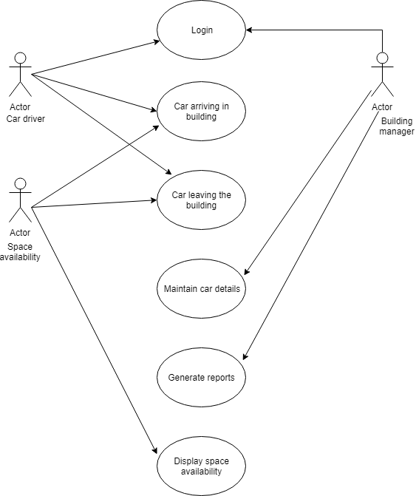
Use-case diagram for parking management system

Slide 19
Generation of test cases from use-cases
There is a systematic approach for the generation of test cases. The approach includes the following steps:
Generation of scenario diagrams
Creation of use-case scenario matrix
Identification of variables in use cases
Design of test case matrix
Assigning actual values to variables

Slide 20
Generation of scenario diagrams
In scenario diagrams the basic flow is one scenario or a complete path through a use-case.
Various alternative paths show another scenario.
Alternative paths are generated by different combinations of alternative flows.

Slide 21
Scenario Diagram
Start use case
Alternative flow 3
Alternative flow 1
Alternative flow 4
Alternative flow 2
end use case
Basic flow
Alternative flow 5
end use case
end use case

Slide 22
Creation of use-case scenario matrix
A use-case scenario matrix gives all possible scenarios of the use-case scenario diagram. Table 2: Use-case scenario matrix
Scenario 1 | Log in successful | Basic flow
Scenario 2 | Login alternative flow: invalid user type | Basic flow | Alternative flow 1
Scenario 3 | Login alternative flow: Invalid user name & password | Basic flow | Alternative flow 2
Scenario 4 | Space not available | Basic flow | Alternative flow 3
Scenario 5 | System down | Basic flow | Alternative flow 4
Scenario 6 | User exists | Basic flow | Alternative flow 5

Slide 23
Identification of variables in use-case
The following use-case variables have been identified for use case Log in.
User type
User login id
User password

Slide 24
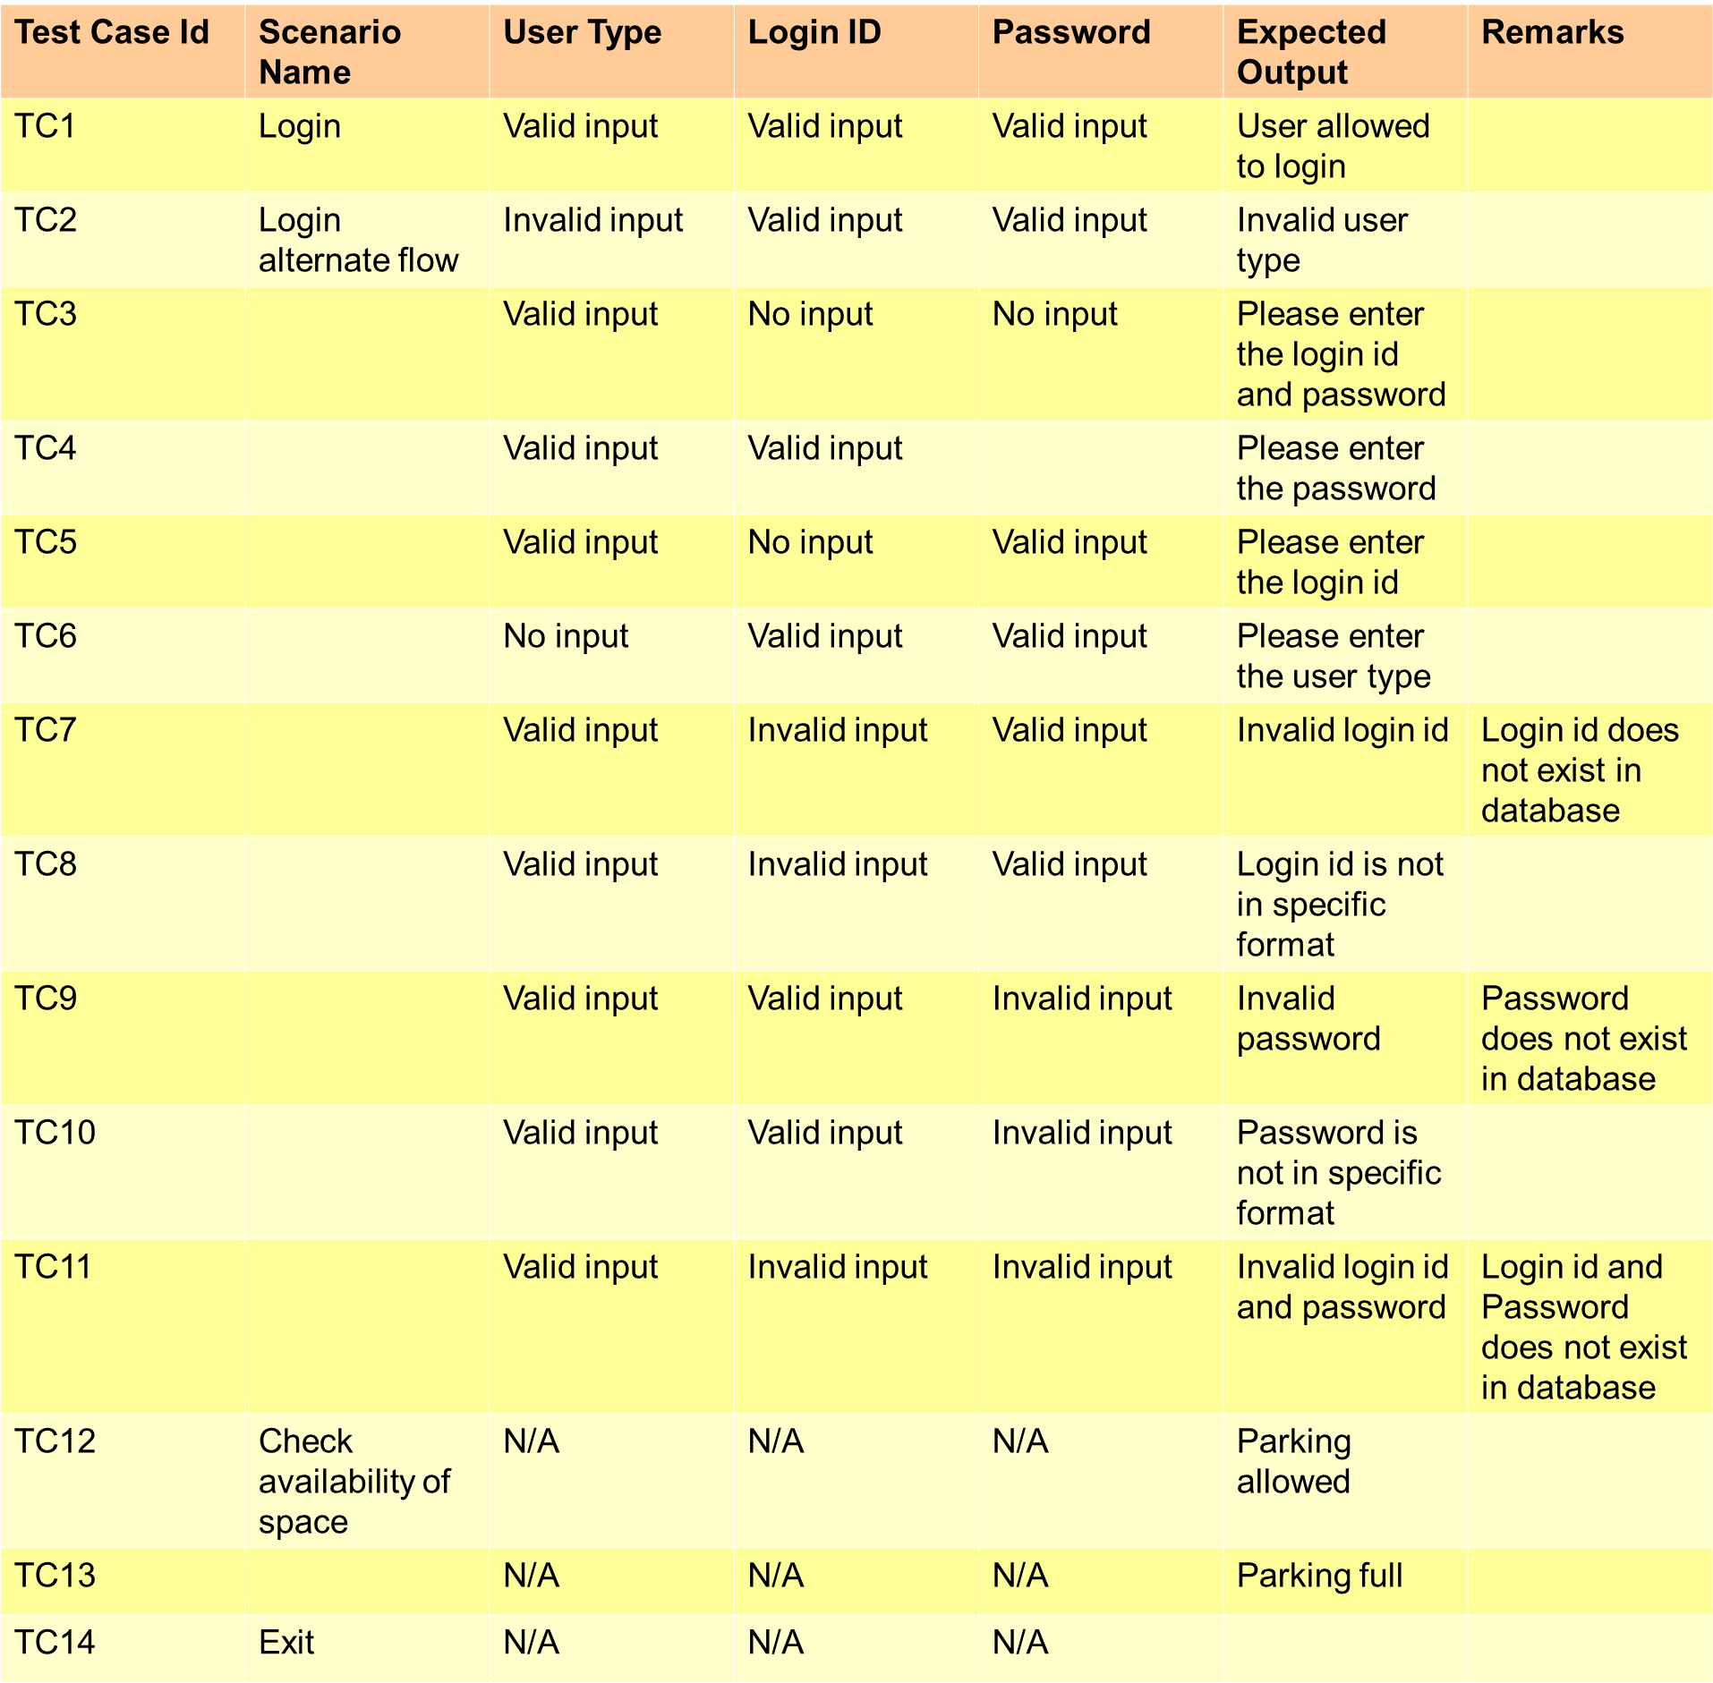
Design of test case matrix

Slide 25
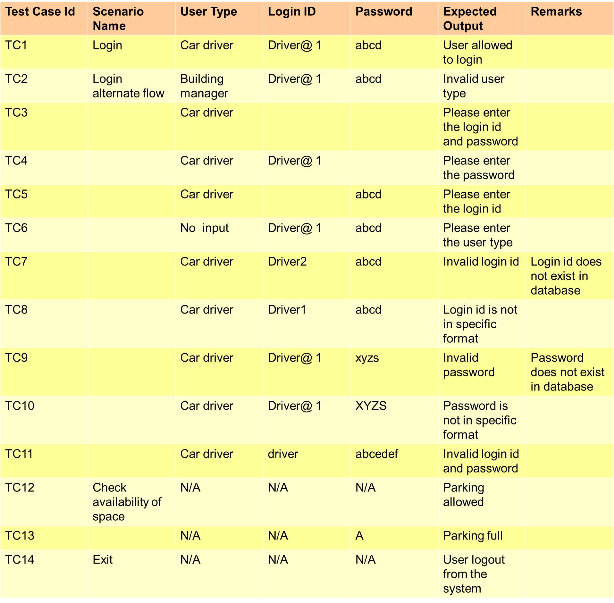
Assigning actual values to variables

Slide 26
Thank you

